Slide 1

Thought Connectors / Joining

Slide 2
According to meaning:
1 – assertive (statement)
2 - interrogative (?)
3 – imperative (order, advice, request)
4 – exclamatory(!)
5 – optative (may)
Types of Sentences
According to tone
1 – Positive (Yes)
2 – Negative (No)

Slide 3
According to Structure
A simple sentence.
(1 subject + 1 finite verb)
A compound sentence.
(2 and more independent Clauses)
A complex sentence.
(1 main clause and subordinate clause )
Types of Sentences

Slide 4
Clause ?
1 – Part of a larger sentence
2 – must have a subject and atleast a finite verb
3 – meaning dependent on the other
4 – sense incomplete,
5 – complete only in togetherness
Example :
The boy who has brown hair, is my brother.

Slide 5
Phrase and Clause
Example: The boy with brown hair, is my brother (Phrase)
Example : The boy who has brown hair, is my brother (Clause)

Slide 6
Phrase v/s Clause
Phrase
Clause
1 – Part of expression
2 – a group of words
3 – no Finite verb
4 – independent sense
5 – not complete sense
1 – part of larger sentence
2 – X
3 – must Finite Verb
4 – Independent sense
5 – complete Sense

Slide 7
Simple Sentence –
1- one action.
2 - It contains a subject (the person or thing doing the action)
3 - a verb (1 finite + /1 infinite).
The cat pounced.
The mouse ran away.

Slide 8
Compound sentence –
1 - usually more than one action.
2 - Two or more simple sentences
3 – all independent
3 – each 1 subject + 1 finite
The cat pounced but
the mouse ran away.

Slide 9
Complex sentence –
1 – more than 1 sentences
2 – main clause (Principle) stands alone
3 – other -dependent or subordinate
While the cat pounced, the mouse ran away.

Slide 10
Sentence
Clause
This is the house
that Jack built.
This is the malt
that lay in the house that Jack built.
This is the rat
that ate the malt that lay in the house that Jack built.
This is the cat
that chased the rat that ate the malt that lay in the house that Jack built.

Slide 11
TYPES OF JOINING/ PARSING
2 simple > 1 complex (Clause – Adj/Adv/Noun)
2 simple > 1 compound (Coordinate Conjunction)
2 simple > 1 simple
1 simple > < 1 complex
1 simple > < 1 compound

Slide 12
Joining
2 simple sentences into
1 complex sentence

Slide 13

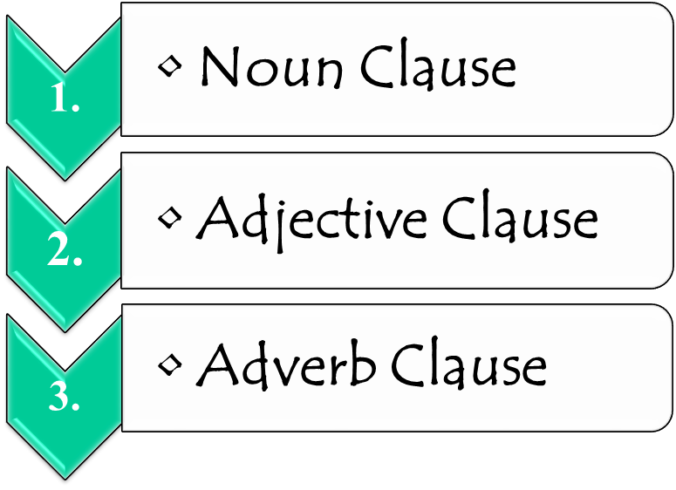
Formation of complex sentence
Clause
Principle Clause Subordinate Clause

Slide 14
Formation of complex sentence
Adjective Clause
TYPE | SUB-TYPE | LINK | EXAMPLE
(Human) | subject | who | The man who was suffering has died
 | Object | Whom | The boy whom you met died
 | Possessive | whose | Ritesh whose performance was good has died
(Non Human) | Subject | That/which | The book which you gifted has lost
 | Object | That/which | I have lost the pen which you gifted
 | Possessive | Of which | The book of which two pages are torn is lost

Slide 15
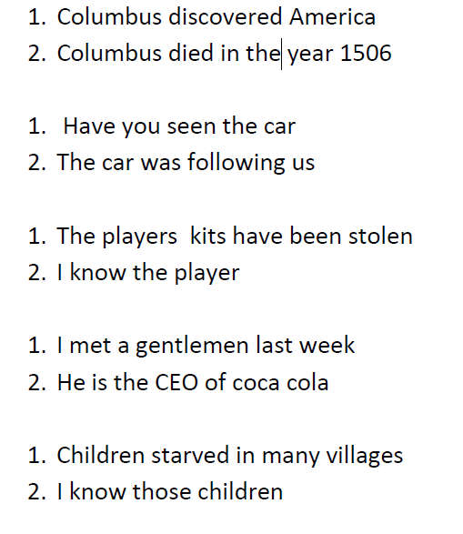
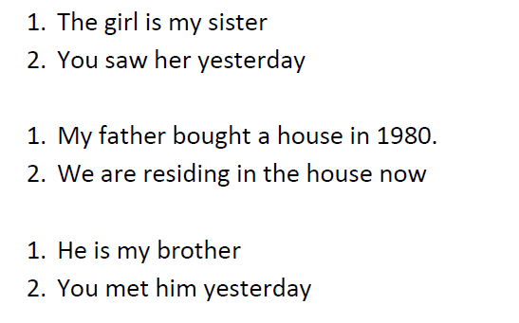
?

Slide 16
Ex- 1: Join the following sentence by adjective clause:
Children starved in many villages. I know those children. The villages are not far away from the town.
B. The principle is known to the geologists. The principle is known as uniformitarianism. It simply means that the processes are operating to modify the earth’s surface.
C. The painting made by Leonardo da Vinci was given as a gift to Lodovico Sforza. The painting is known as Lady with an Ermine. Lodovico Sforza was the patron of Vinci and the Duke of Milan.
D. The ship wrecked in the middle of the Pacific Ocean near the Island of Solomon. The ship’s name was Black Pearl. The Island of Solomon was notorious for sea – dacoits.
E. The man has given the telephone bill to my bother. The bill has no name scribbled on it. My father knows the man.

Slide 17
Formation of complex sentence
Adverb Clause
 | INDICATING | LINK | EXAMPLE
1. | Time | When/While/before/after/since/till /until | He reached the station when it was raining
2. | Place | Where | He reached the place where the accident took place
3 | Cause | As | He reached there by foot as there was no bus
4 | Condition | If | He will reach if you go
5 | Result | So - that | The fire was so great that everything was destroyed
6 | Contrast | Even if /though | The fire was great even though everything is safe
7 | Purpose | So that | Please reach there so that you can avoid rain

Slide 18
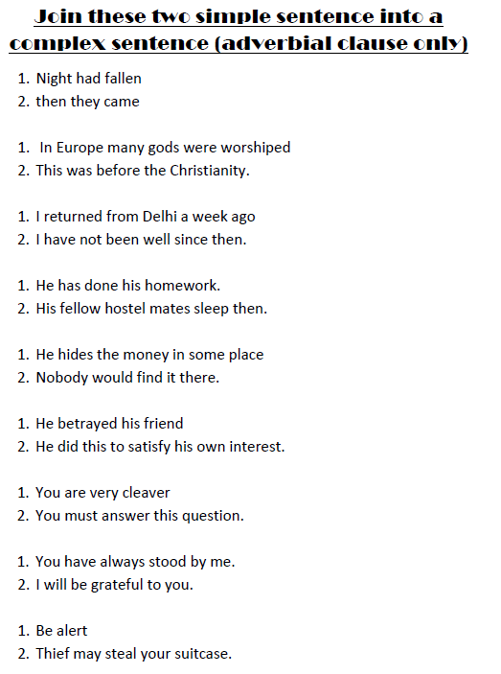

Slide 19
Formation of complex sentence
Noun Clause
Link word – what/that/how/whom/when/whose/where
sl | Function As | Example
1. | As Subject | He is a talented actor + this fact can’t be denied That he is a talented actor can’t be denied. He will come.+ I know the time. I know when he will come. He will come.+ I know the way. - I know how he will come
2. | As Object | He said all. + I believe all. - I believe what he said.
3. | As complement | He will not come.+ He said so. He said that he will not come. Evil is within us.+ it is hell. - Hell is what evil is within us.
4. | Object to preposition | The leader will win the election.+ He is sure of it. - The leader is sure (of) that he will win the election.

Slide 20
Noun Clauses Beginning with Question Words
Wh- clauses begin with words like who, what, how, whenever, which, etc.
  • I need to explain what a noun clause is.
  • I don't know where Mary lives.
  • Tell me how old she is.
First, you need to explain what a noun clause is.
  • What is a noun clause?
  • Where does Mary live?
  • How old is she?

Slide 21
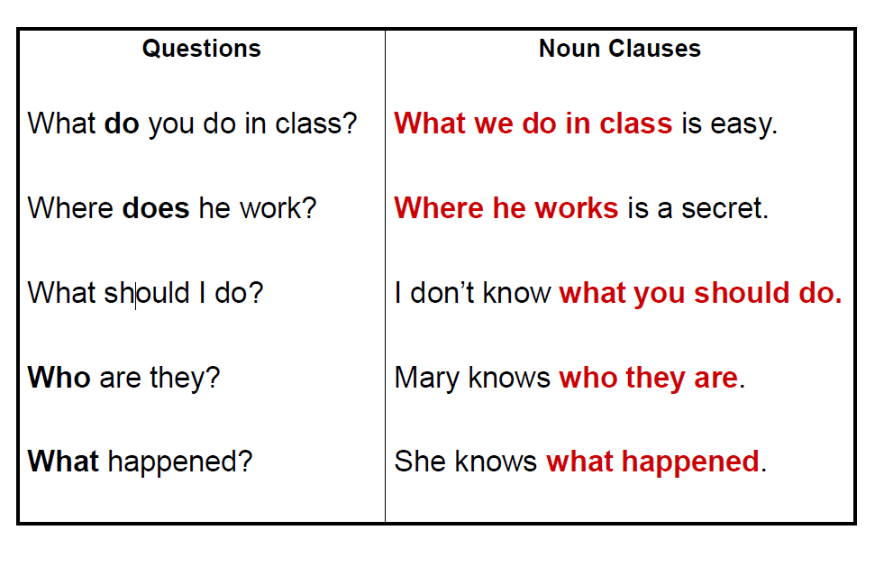

Slide 22
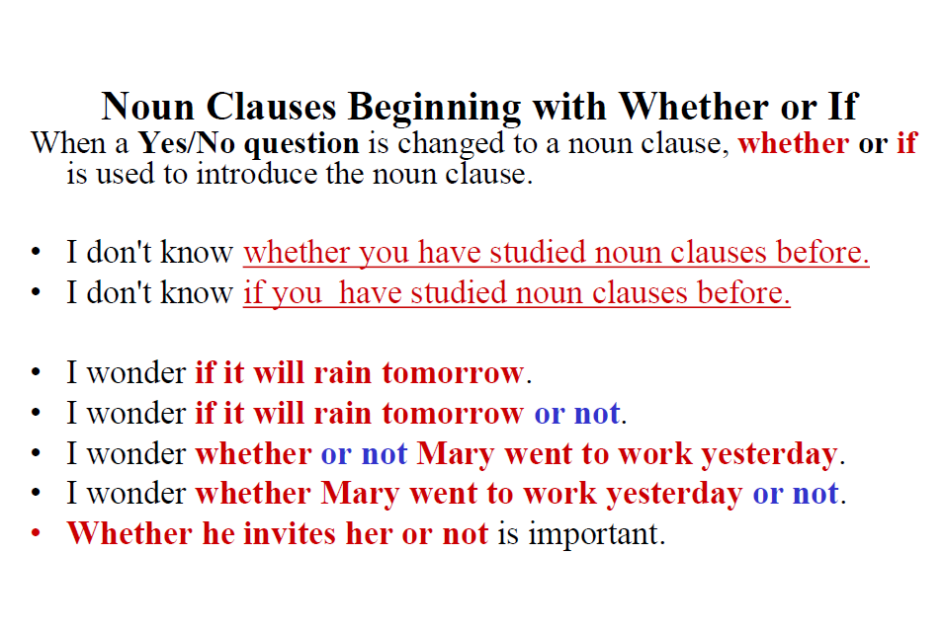

Slide 23
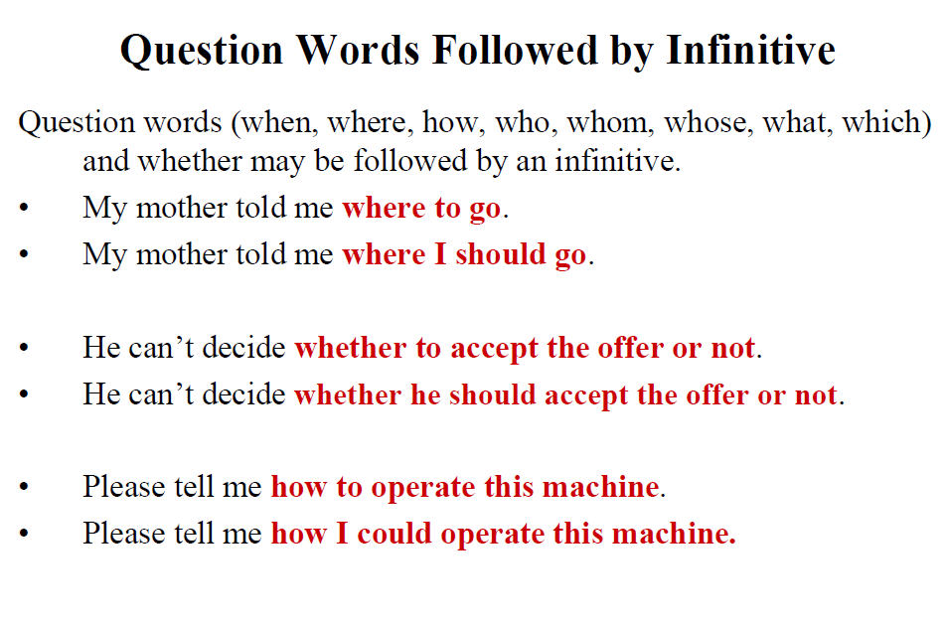

Slide 24
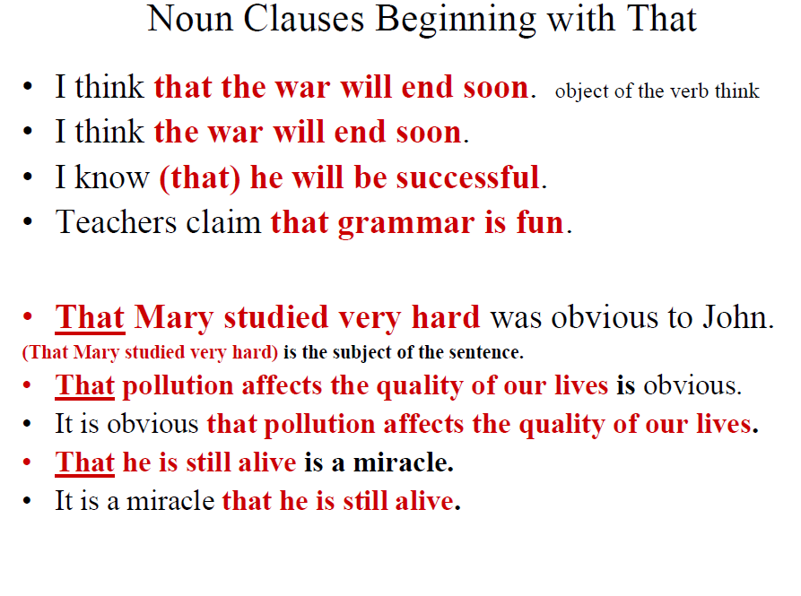

Slide 25
WORKSHEET ON NOUN CLAUSE
1. He will fight to the finish. He says this.
2. She will win the first prize. It is certain.
3. He was innocent. He could not prove that.
4. The manager committed the blunder. It is evident.
5. He will return the money in a couple of days. This is his promise.
6. The patient will recover. This is the doctor’s assurance.
7. They saw the stranger. They say so.
8. Your claims for promotion will not be overlooked. Rest assured.
9. He has committed a mistake. It is obvious.
10. The exams may be postponed. The teacher says this.

Slide 26
Till now
2 simple sentences to 1 complex
Now
One 2 one
Complex > Simple
Simple > Complex

Slide 27
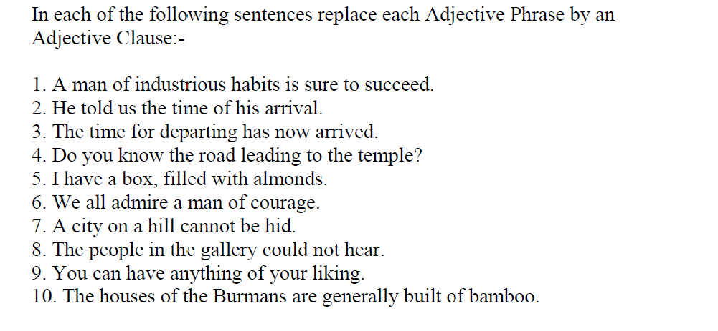

Slide 28
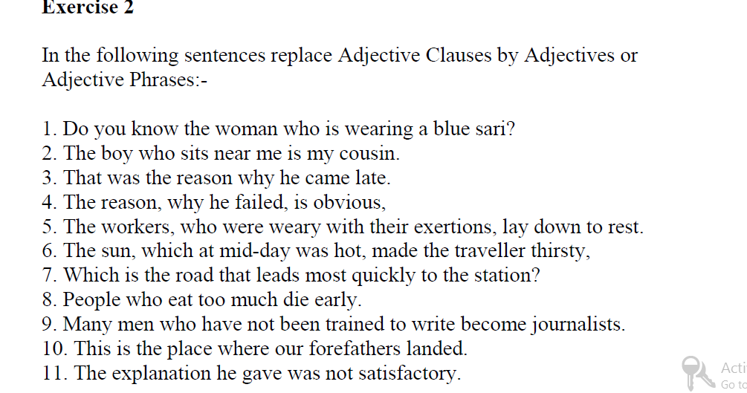

Slide 29
Thank You

